Slide 1

Selenium Library for Data Science
Selenium WebDriver: Automating Web Data Collection for Data Scientists

Slide 2
Table of Content
What is Selenium ?
Industry Examples
Technical Setup and Deep Dive
Library showcase

Slide 3

What is Selenium?
Library: Selenium WebDriver
Purpose: Browser automation and web scraping for dynamic content
Key Capabilities:
Control web browsers programmatically (Chrome, Firefox, Safari, Edge)
Handle JavaScript-heavy websites
Simulate user interactions (clicks, forms, scrolling)
Extract data from complex web applications
Wait for dynamic content to load
Why Data Scientists Need It:
Real-time data collection from websites without APIs
Scraping dynamic content that traditional HTTP libraries can't access
Automating repetitive data gathering tasks

Slide 4


Industry Examples
Job Market & HR Analytics
Use Cases:
Salary Benchmarking: Collecting compensation data from job postings across industries
Skills Demand Analysis: Identifying trending skills and technologies in job descriptions
Talent Pool Mapping: Tracking where companies are hiring and for what positions
Recruitment Intelligence: Monitoring competitor hiring patterns and organizational growth
Example: HR consultancies build comprehensive salary databases by scraping 100,000+ job postings monthly, providing clients with market-rate compensation recommendations.

Slide 5

Industry Examples
Travel & Hospitality Intelligence
Use Cases:
Dynamic Pricing Analysis: Tracking hotel and flight prices across booking platforms
Occupancy Rate Estimation: Monitoring availability patterns to estimate demand
Review Aggregation: Collecting customer reviews from multiple travel platforms
Competitive Benchmarking: Comparing amenities, pricing, and customer satisfaction metrics
Example: Hotel chains scrape competitor pricing data 24/7 to optimize their revenue management systems and adjust room rates dynamically.

Slide 6
Technical Setup and Deep Dive

Slide 7
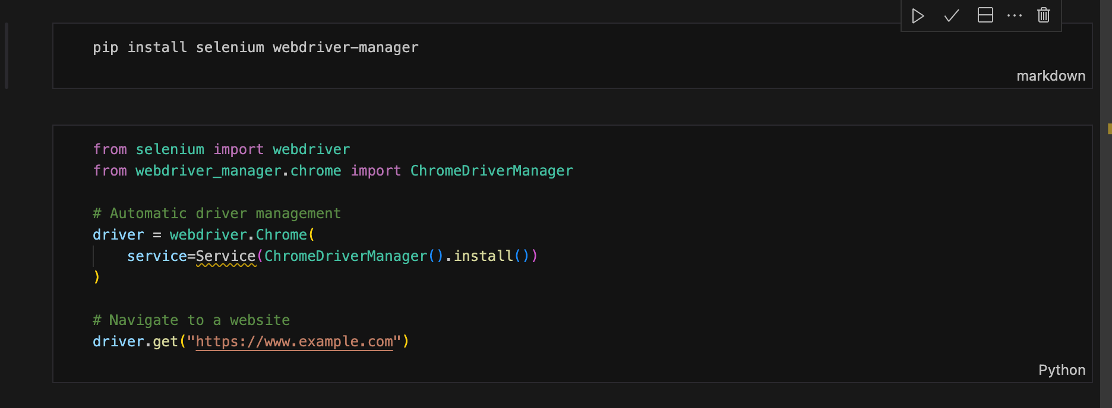
Installation & Setup

Slide 8
Core Selenium Concepts

Slide 9
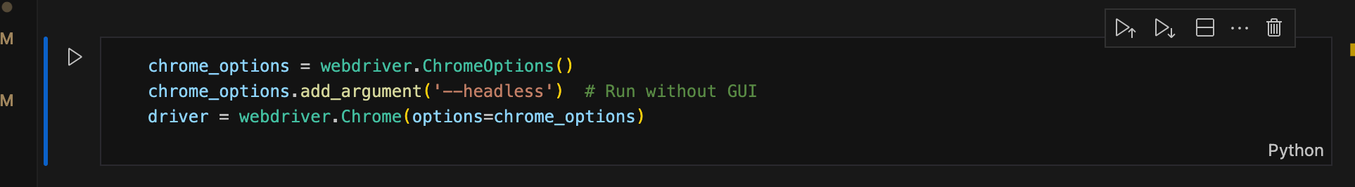
1. WebDriver Initialization

Slide 10
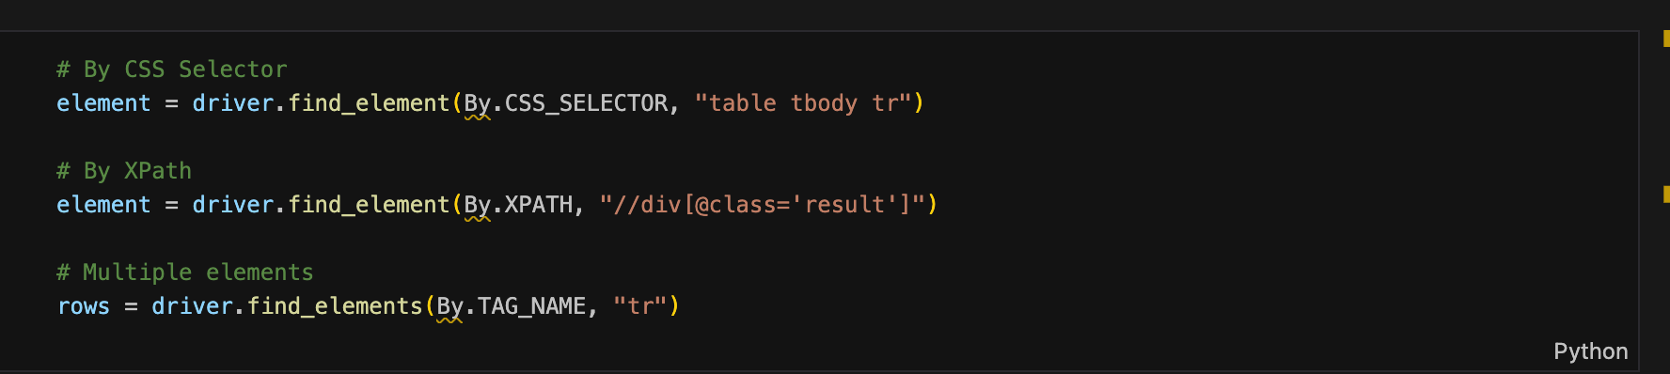
2. Finding Elements

Slide 11
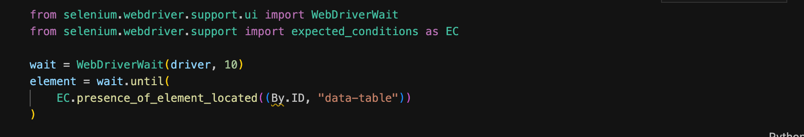
3. Waiting for Dynamic Content

Slide 12
Library Showcase

Slide 13

Real World Example - F1 Data Scraping
Target: Formula 1 Official Website (https://www.formula1.com)
Data Collection Goals:
Race results (winners, dates, circuits)
Driver championship standings
Constructor (team) standings
Multi-season analysis (2023 vs 2024)
Why This Example?
Dynamic JavaScript-loaded content
Demonstrates waiting strategies
Real tables requiring parsing
Multi-page navigation
Practical sports analytics use case

Slide 14
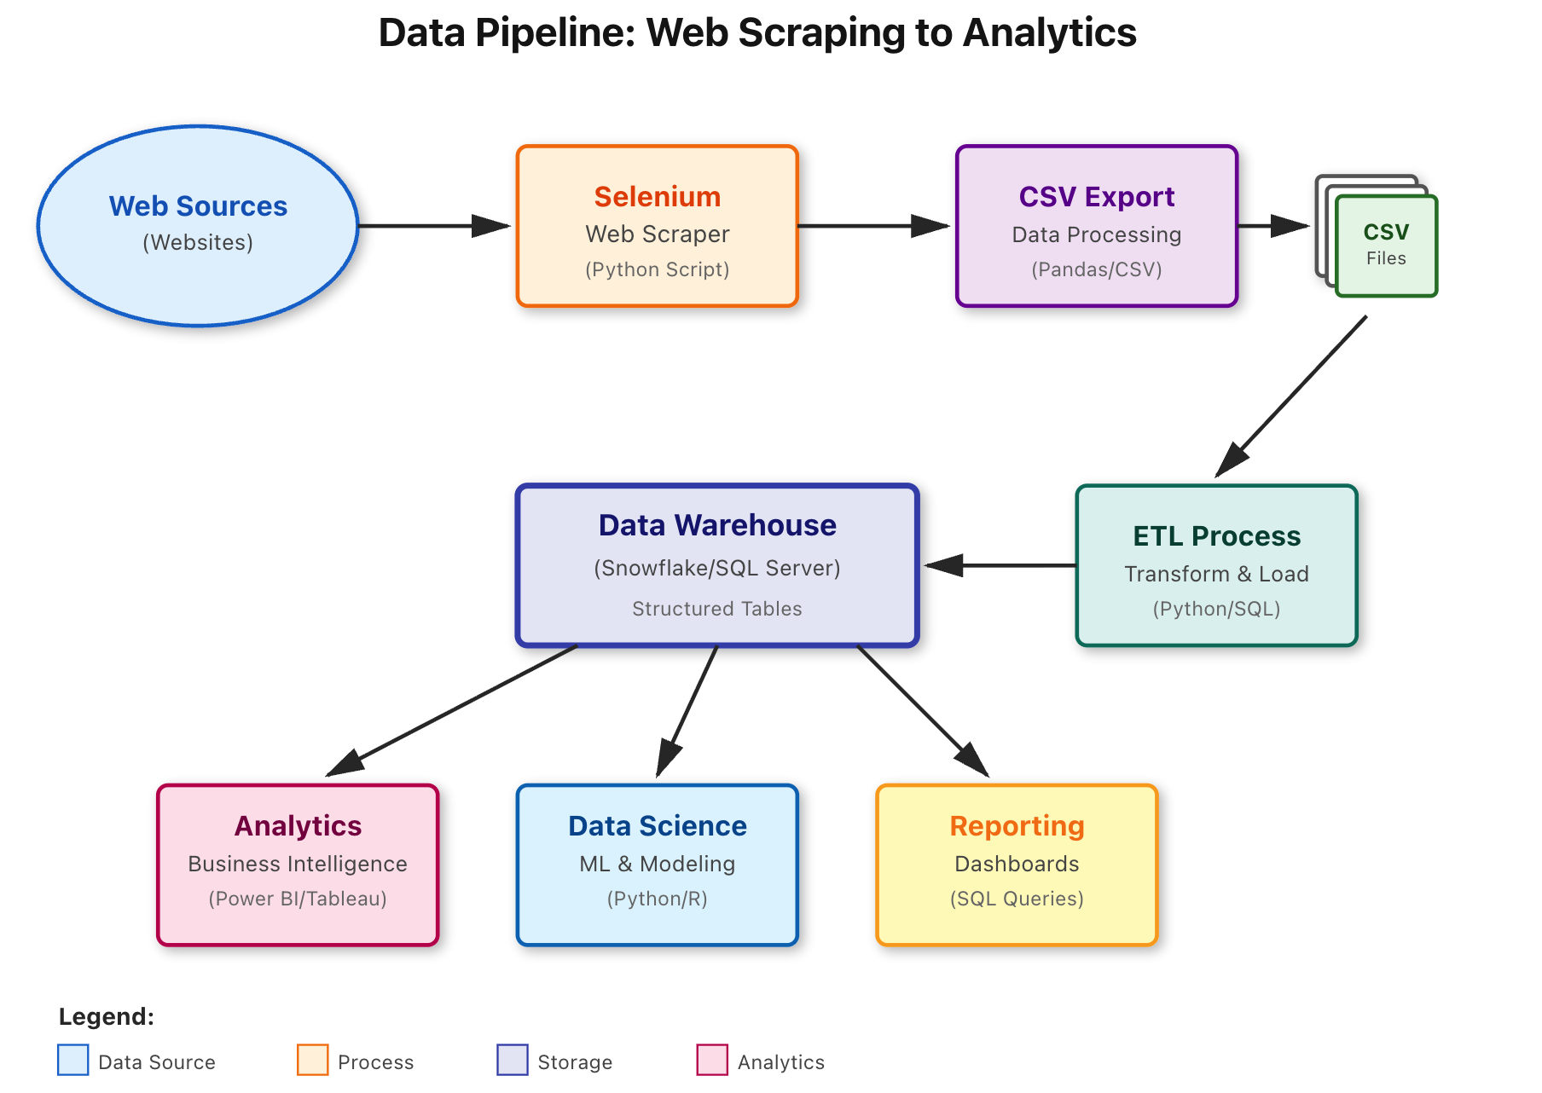

Slide 15

Code Walkthrough

Slide 16
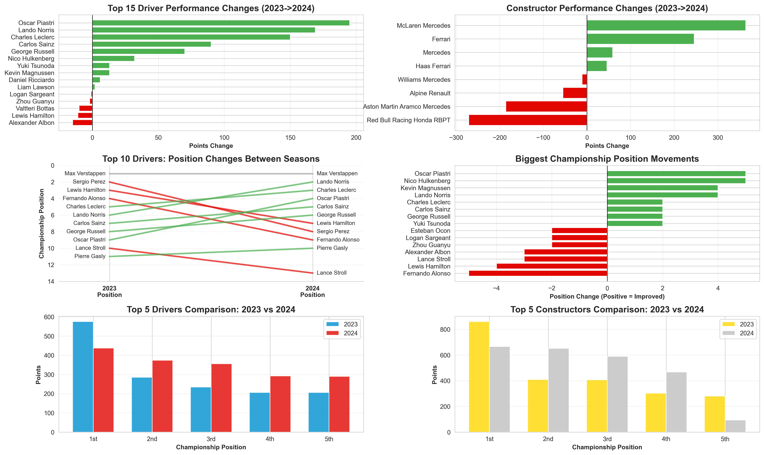
Display Result

Slide 17
Thank you !
Any Questions ?

